Slide 1
Data Analysis & Visualisation

Slide 2
agenda
Numpy
Pandas
Matplotlib
SeaBorn
Final tips & takeaways

Slide 3
SET UP ENV IN VS CODE
Step-0: Prerequisites (one-time) :- python –version
Step-1: Open your project folder in VS Code
Step-2: Open Terminal in VS Code
Step-3: Create virtual environment :- python -m venv venv
Step-4: Activate virtual environment 🔹 Windows (PowerShell) :- venv\Scripts\activate
Step-5: Select venv interpreter in VS Code (IMPORTANT) :- 1)Press:-Ctrl + Shift + P 2) Type:-Python: Select Interpreter 3) Choose:-Python ... (venv)
Step-6: Install packages inside venv :- pip install numpy pandas matplotlib Check:- pip list
✅ Step-7: Verify venv is working :- Create test.py:-import numpy
print(numpy.__version__)

Slide 4
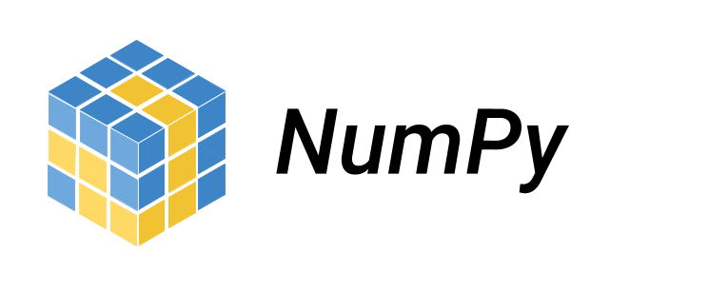
INTRODUCTION TO NUMPY

Slide 5
NumPy is a Python library used for working with arrays. It also has functions for working in domain of linear algebra, fourier transform, and matrices. NumPy was created in 2005 by Travis Oliphant.
It is an open source project and you can use it freely.
NumPy stands for Numerical Python.

Slide 6
In Python we have lists that serve the purpose of arrays, but they are slow to process.
NumPy aims to provide an array object that is up to 50x faster than traditional Python lists.
The array object in NumPy is called ndarray, it provides a lot of supporting functions that make working with ndarray very easy.
Arrays are very frequently used in data science, where speed and resources are very important.

Slide 7
Why is NumPy Faster Than Lists ?
NumPy arrays are stored at one continuous place in memory unlike lists, so processes can access and manipulate them very efficiently.
This behavior is called locality of reference in computer science.
This is the main reason why NumPy is faster than lists. Also it is optimized to work with latest CPU architectures.

Slide 8
BASIC OPRETIONS OF NUMpY

Slide 9
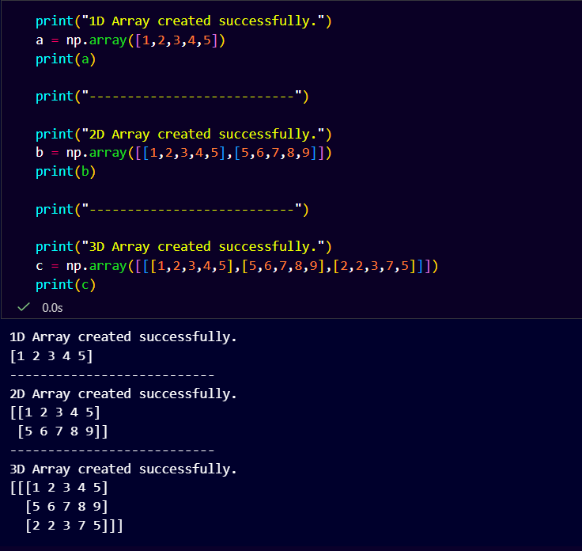
array
NumPy is used to work with arrays. The array object in NumPy is called ndarray.
Creation :-We can create a NumPy ndarray object by using the array() function.

Slide 10
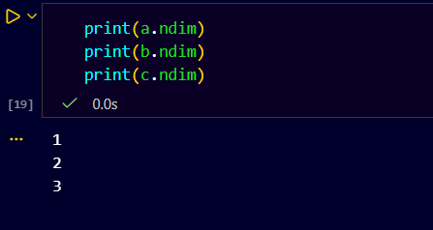
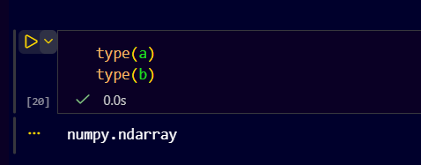
Ndim :-NumPy Arrays provides the ndim attribute that returns an integer that tells us how many dimensions the array have.
Type():- it returns type of a

Slide 11
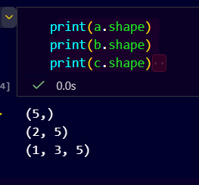
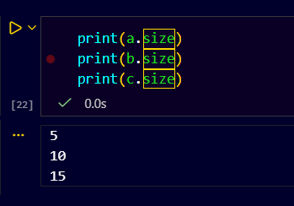
size :-IT returns a size of array
SHAPE :- Shape(rows,col)

Slide 12
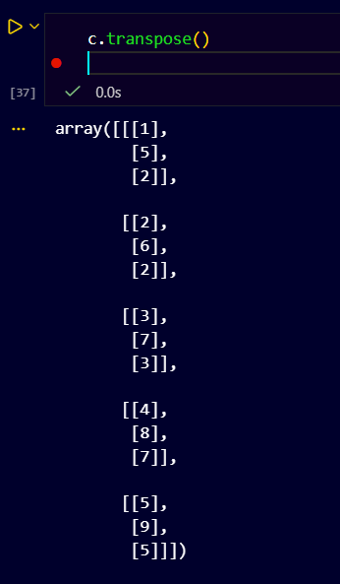
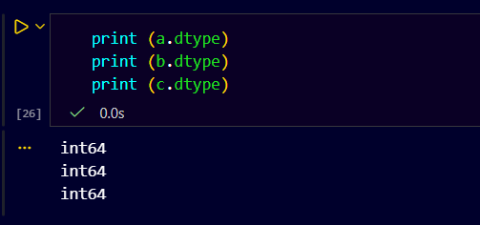
Transpose :- it give transpose of a matrix
Dtype :- It returns a which type of data stored in array .

Slide 13
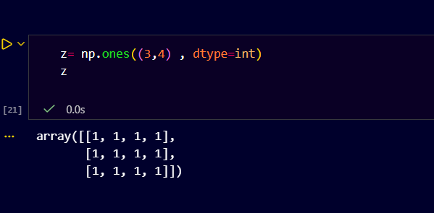
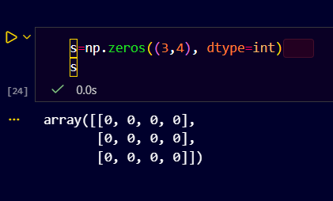
4️⃣ Feature engineering
When adding columns or features:
initialize with default values
later update selectively
Np.ones : 1️⃣ Initialize data
Creates a matrix already filled with known values.
2️⃣ Testing & debugging
Before using a real dataset:
test formulas
test indexing/slicing
test logic safely

Slide 14
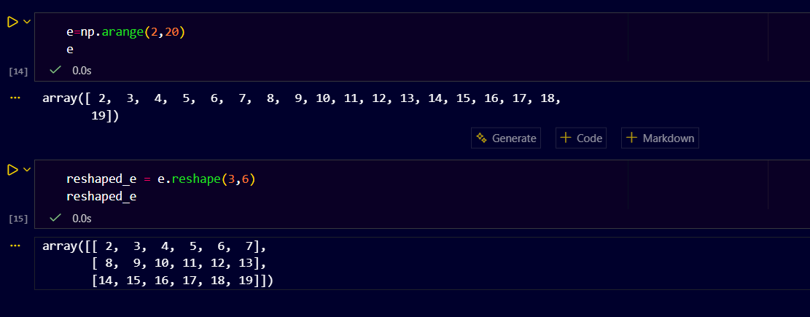
np.arrange :- np.arange() creates evenly spaced values within a given interval, similar to Python’s range() but returns a NumPy array.
np.arange(start, stop, step, dtype=None)
start → starting value (included)
stop → ending value (excluded)
step → difference between values
dtype → data type (optional)

Slide 15
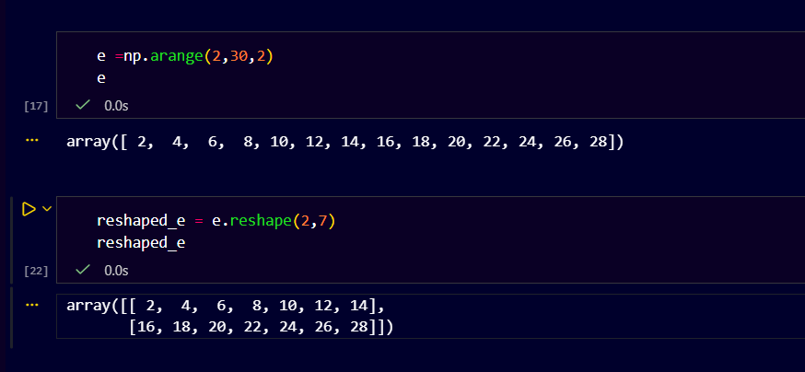

Slide 16
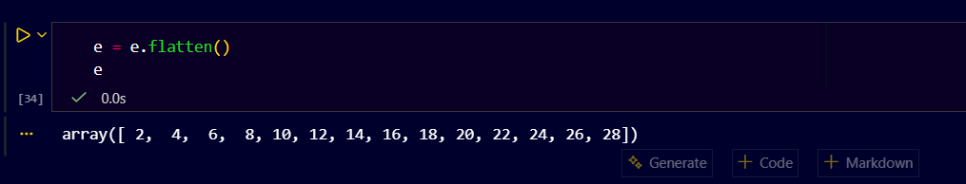
🔹 What is flatten()?
flatten() converts a multi-dimensional NumPy array into a 1-D array.
flatten() returns a copy, not a view.

Slide 17
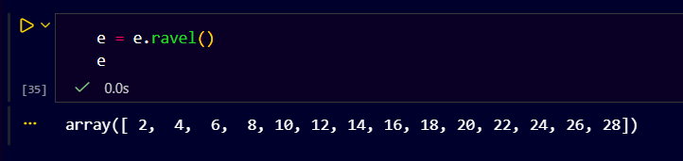
Ravel()
Converts a NumPy array into a 1-D array
Returns a view (if possible), not a copy

Slide 18
ravel() vs flatten()
✅ Use ravel() when:
Performance matters
Large datasets
Read-only or temporary use
Feature | ravel() | flatten()
Returns | View (if possible) | Copy
Memory | Efficient | Uses extra memory
Speed | Faster | Slightly slower
Changes affect original? | ⚠️ Yes | ❌ No
Safe to modify? | ❌ | ✅
✅ Use flatten() when:
You will modify the result
You need data safety
ML preprocessing steps

Slide 19
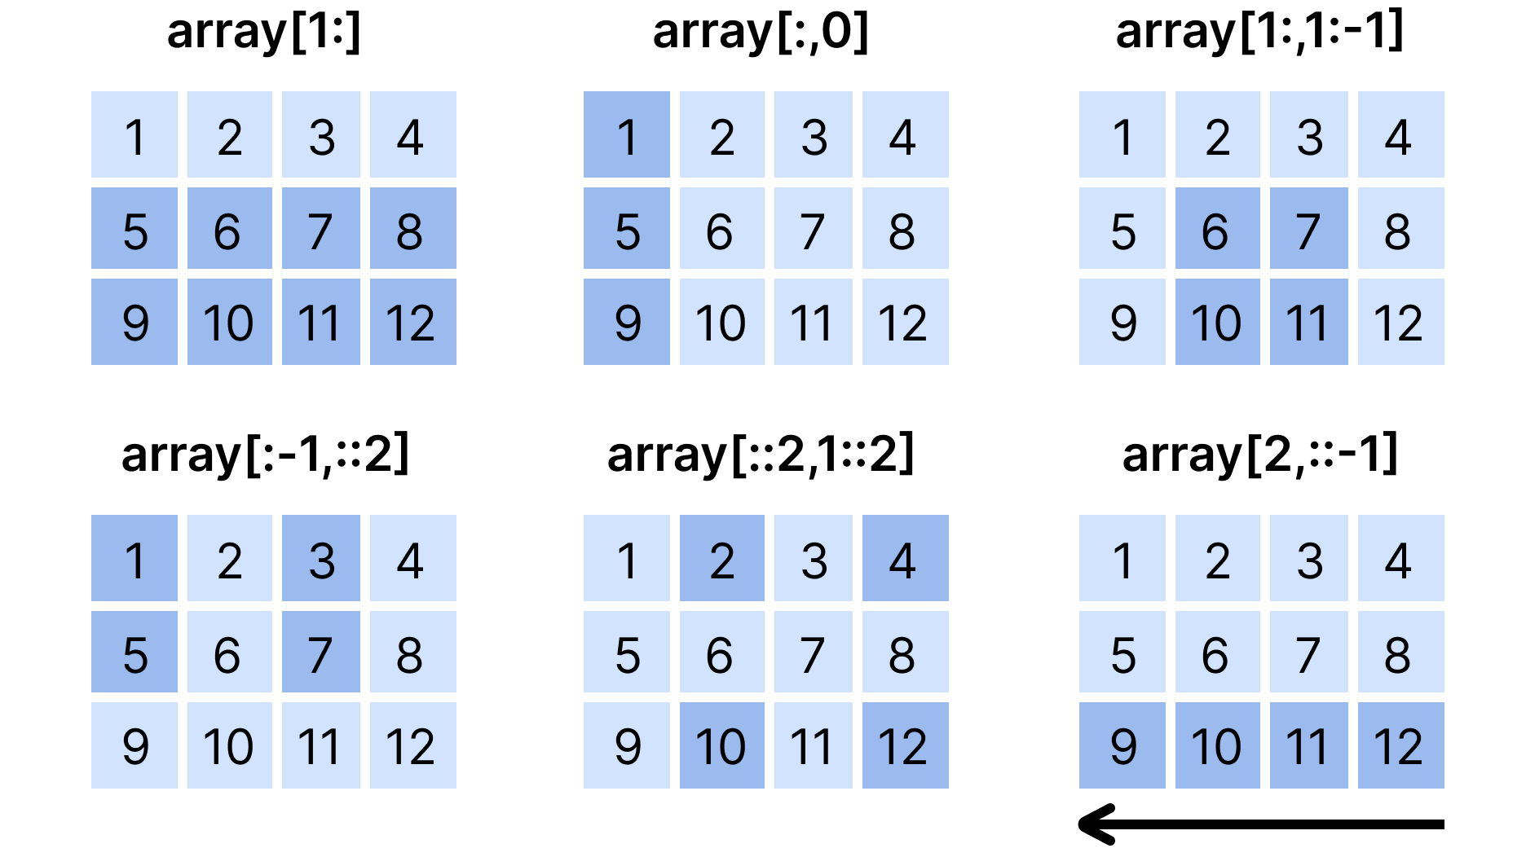
SLICING
Slicing in python means taking elements from one given index to another given index.
We pass slice instead of index like this: [start:end].
We can also define the step, like this: [start : end : step].
If we don't pass start its considered 0
If we don't pass end its considered length of array in that dimension
If we don't pass step its considered 1

Slide 20
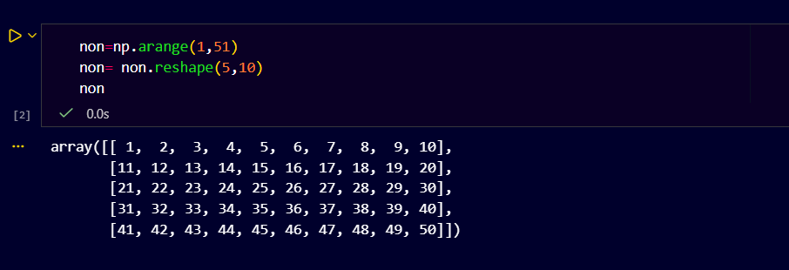
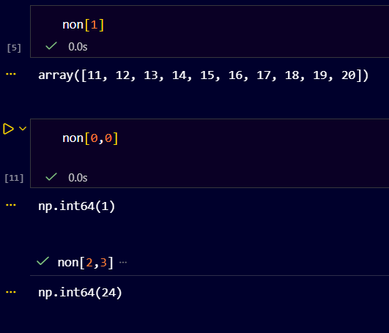
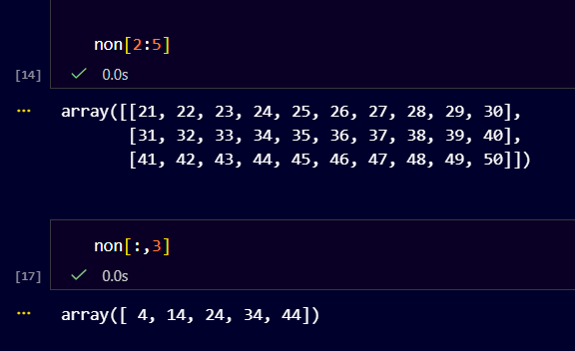
Slice elements from index 1 to index 5 from the following array:

Slide 21
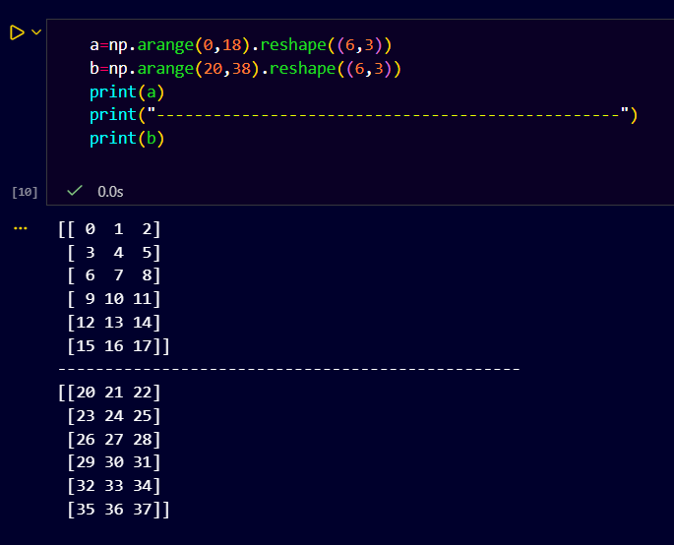
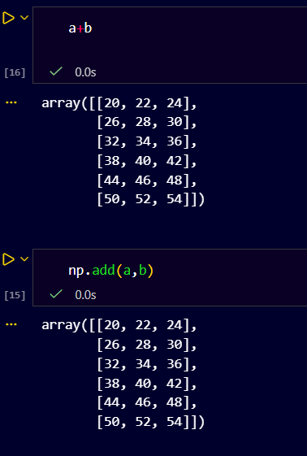
ARITHMATIC OPREATIONS
ADDING ARRAY

Slide 22
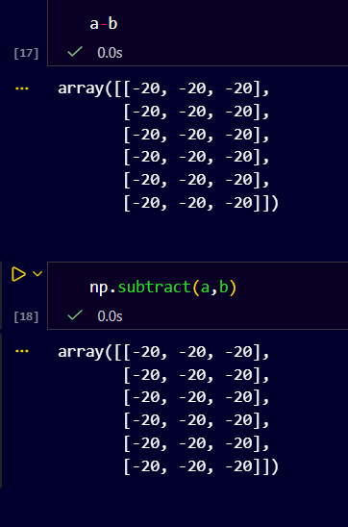
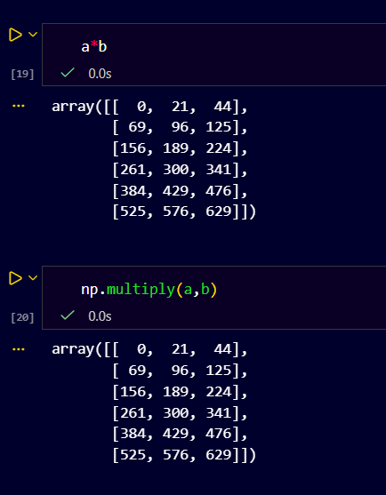
SUBSTRACTION
MULTIPLICATION
MULTIPLICATION IS WHICH WE LEARN COLUMN MULTIPLY ROW AND ADD , IT MULTIPLY ONLY BASIS ON INDEX SUCH AS (0,1)*(0,1)
NORMAL MULTIPLY WE SEEN AFTER DIVISION

Slide 23
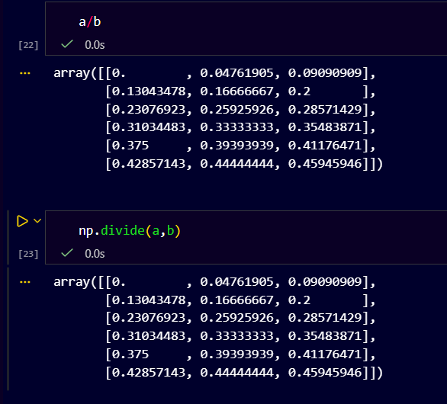
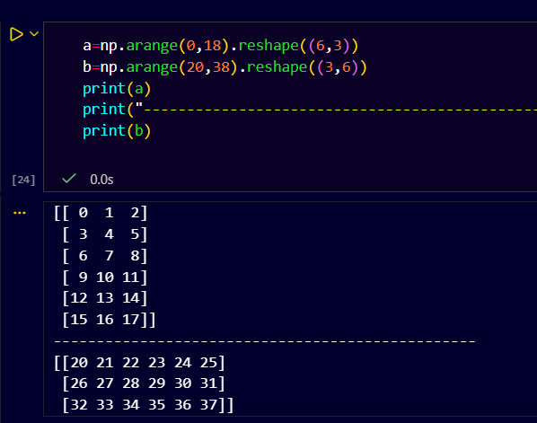
DIVISION
MULTIPLY(ROW*COLUMN)
We have to make row of first matrix = col of second matrix

Slide 24
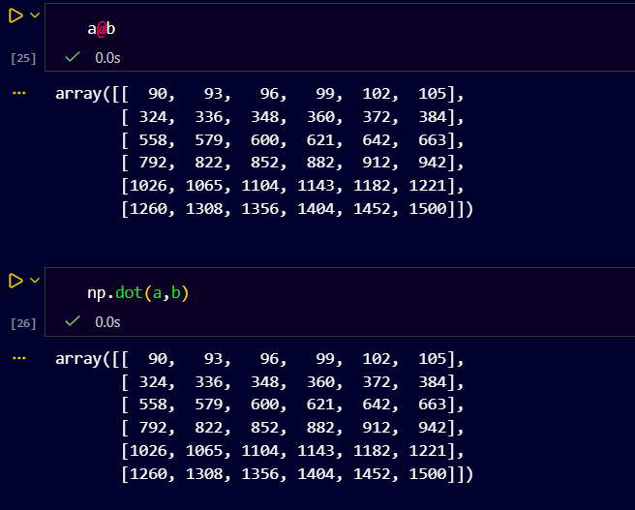
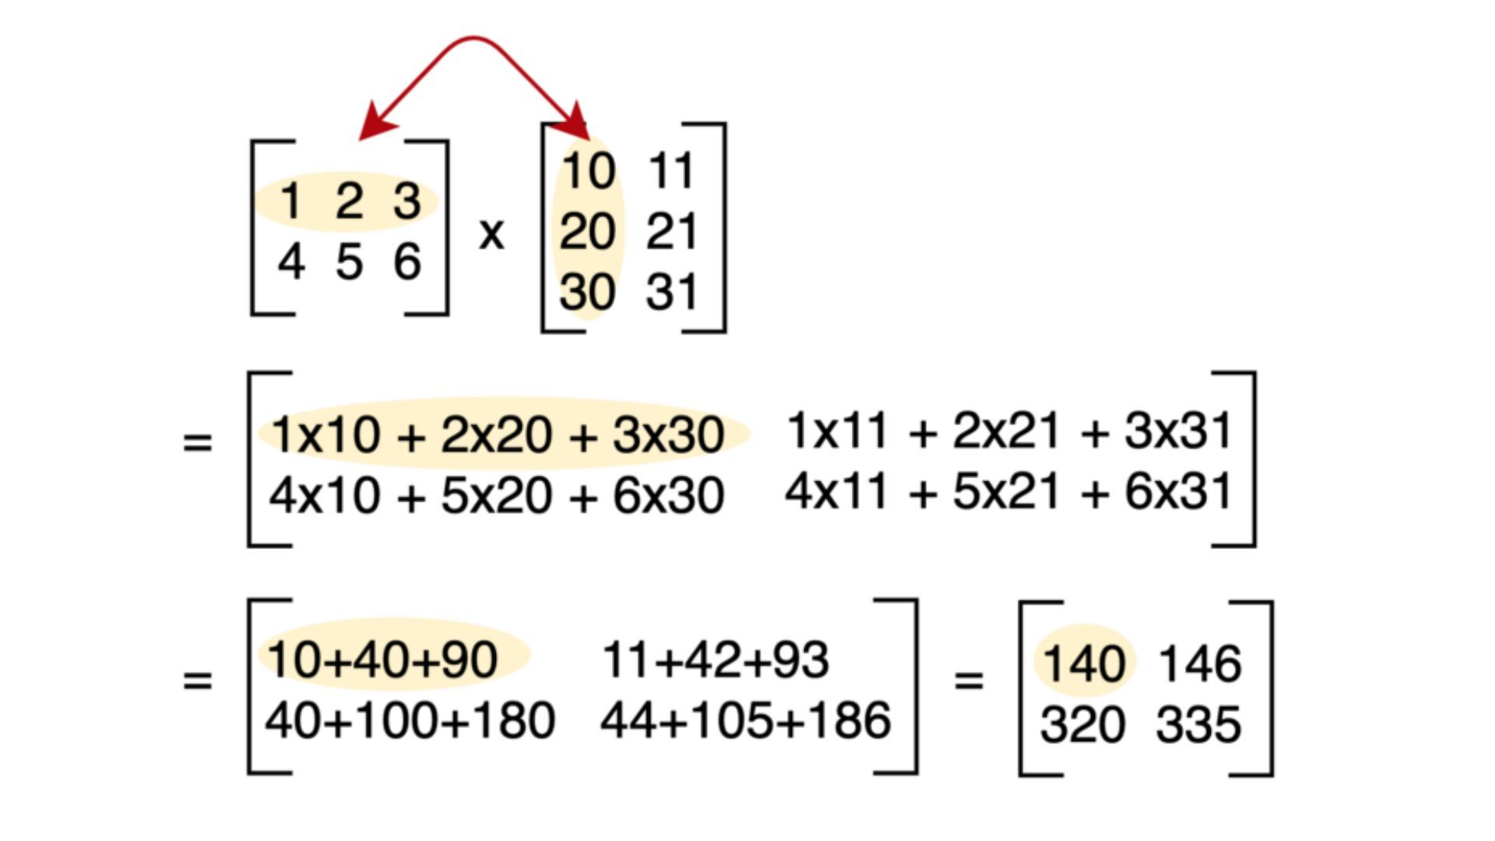
MULTIPLY(ROW*COLUMN)
It is dot product of two matrix

Slide 25
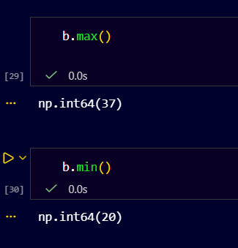
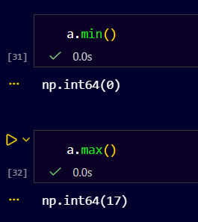
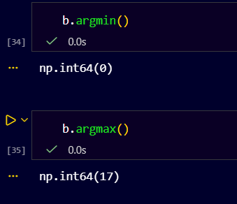
MAX AND MIN OF ARRAY

Slide 26
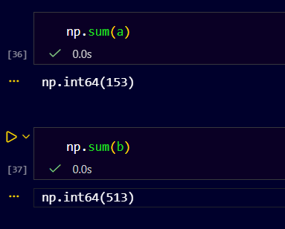
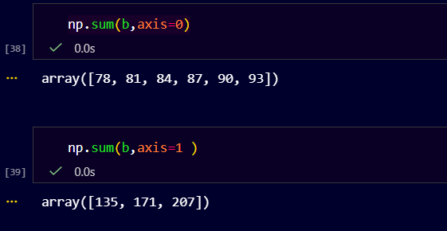
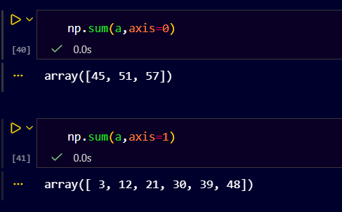
Sum of all element of array
SUM OF ALL ELEMENTS IN ARRAY ROWWISE AND COLUMNWISE
Axis=0 :- returns columnwise sum , axis =1 returns row wise sum

Slide 27
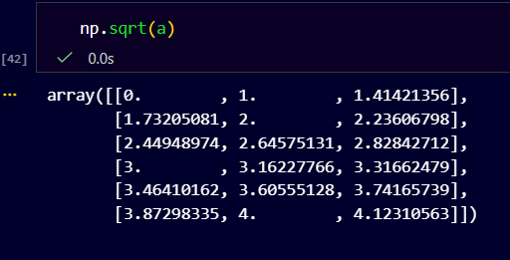
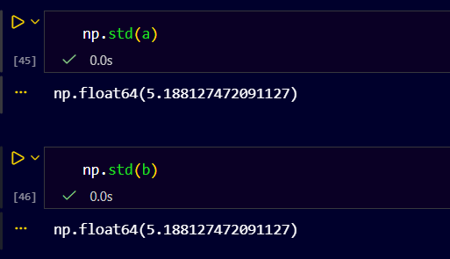
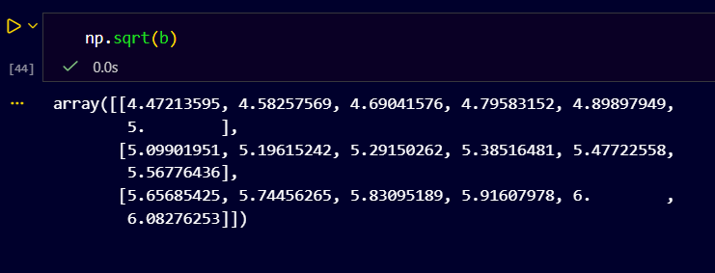
FINDING SQUARE ROOT OF ARRAY
FINDING STD DEVIATION OF MATRIX

Slide 28
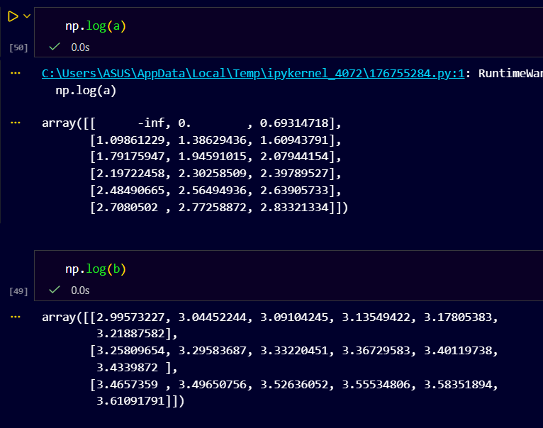
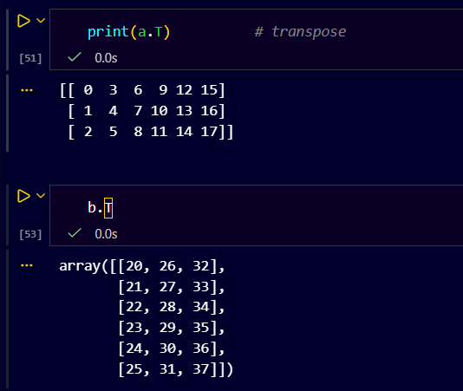
Find log of element in the array
Find the transpose of matrix

Slide 29
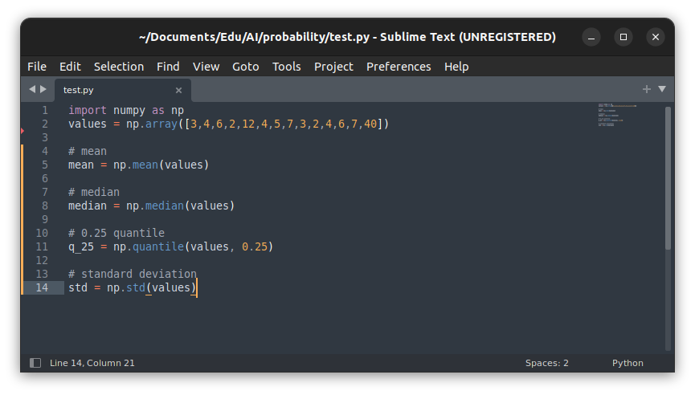
🔹 What does mean do?
It calculates the sum of values ÷ number of values.

Slide 30
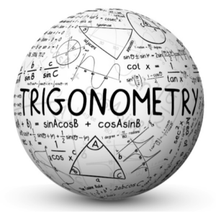
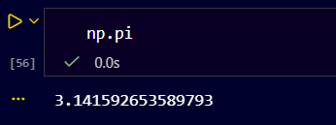
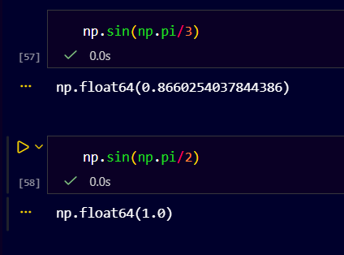
Trigonometric operations
First import matplotlib because we ploting the graphs of trigonometric functions
First stated value of pi by :- np.pi
FINDING VALUES BY USING np.sin(np.pi/3) #60 degree

Slide 31
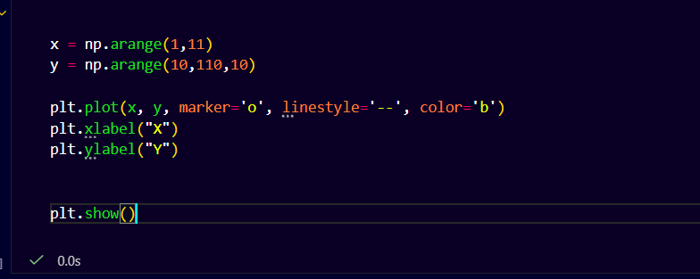
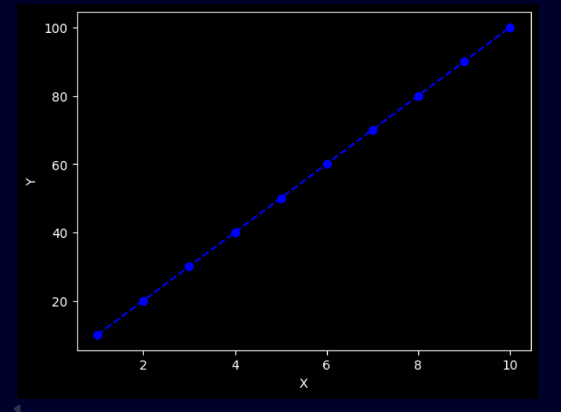
Graphs
Straight line

Slide 32
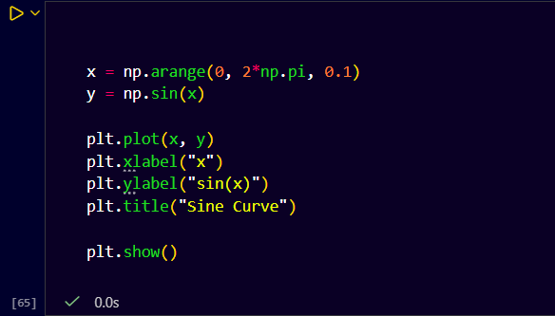
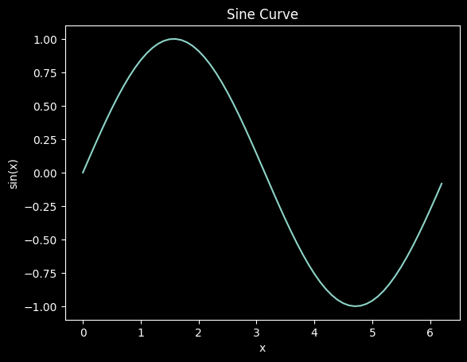
Sin curve

